Slide 1
Coursera capstone project
Tim Kreutzfeldt

Slide 2

Introduction
On 1/1/21, OpenBox Athletics in Philadelphia burned down overnight
Gym ownership is now looking for a new location to run the gym
Can we use data science to determine an optimal new gym location?

Slide 3
Data
Our goal will be to locate an optimal new gym location in the same zip code to maintain OBA’s member base
We will use two data sets
Geographical data about the 19146 zip code (.SHP files)
Foursquare API data about rival gyms in the area

Slide 4
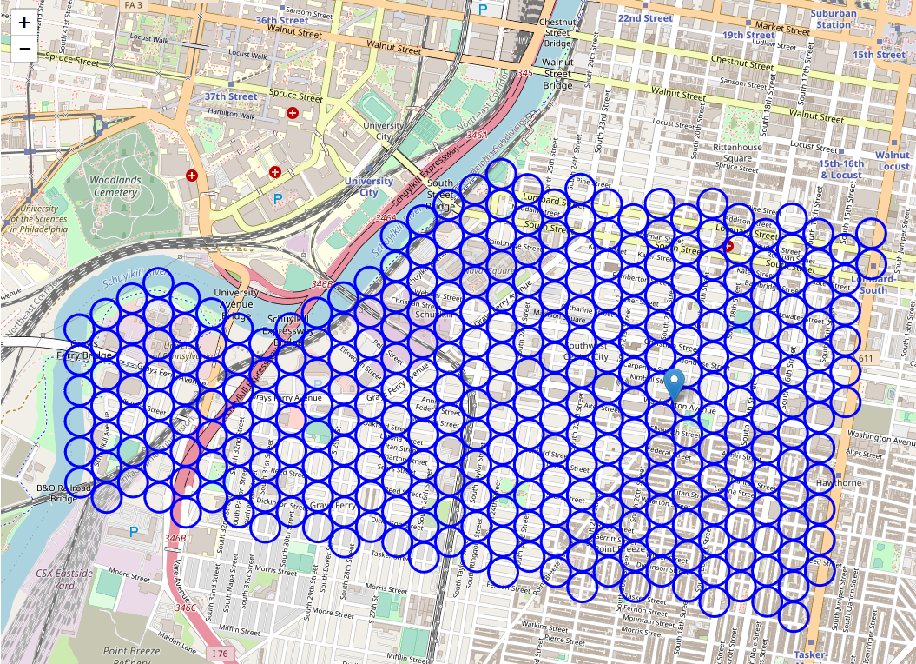
Geographical Data
We created a grid of city blocks in the 19146 zip code using open source .SHP files
End result was a grid of 318 candidate locations for OBA

Slide 5
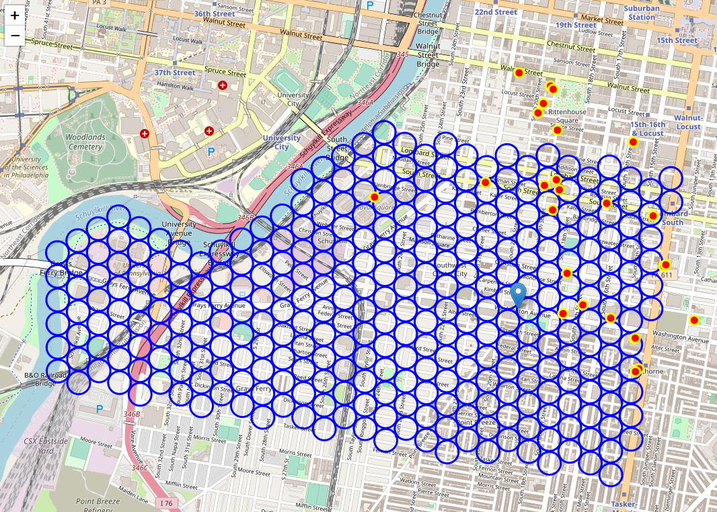
Data: Foursquare api
The Foursquare API was used to collect locations of rival gyms in the area
Superimposed locations of rival gyms on grid of candidate locations

Slide 6
Methodology
Objective: Find a new location which will allow OpenBox Athletics to be the closest proximity gym to the largest number of 19146 residents
Two key assumptions were made
Gym customers choose their gym based solely on closest proximity to their home
An equal number of residents lives in each city block in 19146
To find optimal gym location: count the number city blocks for which each candidate location would be the closest gym

Slide 7
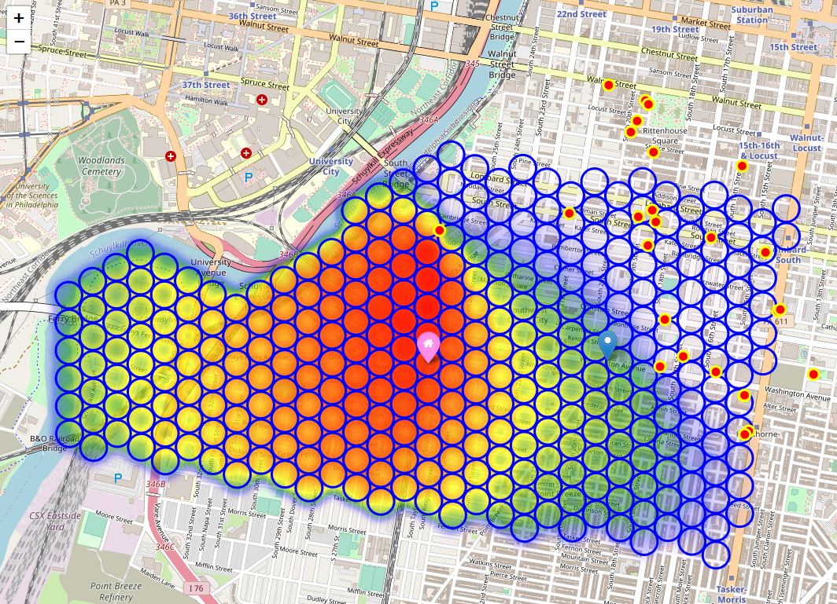
Results
Number of city blocks for which each candidate location would be the closest gym was plotted as a heat map
Optimal location: Intersection of 25th and Kimball (155 city blocks)

Slide 8
Discussion
Intersection of Kimball and 25th is a residential area which may not be a good fit for a new gym
One street south (Washington Ave) is more commercial but still would capture a large number of city blocks (153) for which OBA is the closest gym in 19146
Washington and 25th is recommended as the optimal gym location based on the data
More data could improve the results
Examples: Population data about each city block and demographic data about what type of customer OBA is trying to attract

Slide 9
Conclusion
Several data science tools were able to be utilized effectively for the purposes of this project
API calls (Foursquare)
Python data structures (Pandas dataframes)
Python map data (Folium package)
More data can be employed to refine this project in the future
Make model more robust by weighting each grid point by population density

